Slide 1
SFC2014
General MS Training
System for Fund management
in the European Community
2014-2020

Slide 2
SFC2014 Course
SFC2014 Introduction & Basic Concepts
Support
Question & Answer Session
Nodes
Using SFC2014
SFC2014 Workflow
Document Management
The CCI number
Access & Security
Documentation
Practical Demo
How to login
Navigating
Notifications
Operational Programmes
Other Objects

Slide 3

SFC2014: Shared Management
SFC2014 Introduction
SFC2014 application is a shared management tool:
  Platform used by EC and MS for EU funds management
  Period: 2014-2020
  Electronic data exchange
Used by 5 EC Directorate General:
  EMPL - Employment, Social Affairs & Inclusion
  REGIO - Regional Policy
  AGRI - Agriculture and Rural Development
  MARE - Maritime Affairs and Fisheries
  HOME - Home Affairs

Slide 4
SFC2014: Shared Management
SFC2014 Introduction
Centralisation and standard format of data
Interactive action between MS and EC
Real time information
  Data & Document Upload & Submission (by MS)
  Uploading documents & Following workflow (by EC)
  Reporting
Data consistency
Transparency

Slide 5

Legislation
SFC2014 Introduction
SFC2014 is described in Article 74(4) of the Regulation (EU) No 1303/2013 of the European Parliament and of the Council of 17th December 2013
The SFC2014 Implementing Act is the Commission Implementing regulation No 184/2014
Available on the SFC Portal : http://ec.europa.eu/sfc/en/2014/about-sfc2014

Slide 6
Workflow in SFC2014
SFC2014 Introduction
SFC 2014
Calculations
Data Validation
Notification of events
EC
Member
State
Information
Verification
(change of
status)
Document
Upload
Data Entry
& Submission
Document Upload

Slide 7
SFC2014: The Application
Access & Security
Access:
  Web Application
  Login: ECAS protected
→ Usernames are personal!
Users must create ECAS account
ECASuid sent to Liaison Officer
Liaison creates access request
Validated by the SFC Support team
User and Liaison receive email confirmation when access request processed
Each user granted access to view or update programmes related to the funds of the DG and the Country for the Member State.

Slide 8

Access & Security
Access & Security
Liaison officers:
MS Liaison and Deputies
Nominated per Member State
In charge of User Management
  Verification of user entitlement (Roles/Fund)
  Creation of access request via SFC2014 User & Security Module (USM)
  Update of user roles/access

Slide 9
User Roles
Access & Security
Different roles granted to read, update or send data & documents at MS level:
  Managing Authority (MSMA), Certifying Authority (MSCA), Audit Authority (MSAA)
Different roles granted for users to read, send/update documents/status at EC level:
  EC Operation Agent (ECOA) EC Audit Agent (ECAA)
  Dealing with a programme in SFC2014
  Changing status, uploading documents (if necessary)

Slide 10
Roles
Access & Security
Function
MS Authority (MSA)
MS Audit Authority (MSAA)
MS Managing Authority (MSMA)
MS Certifying Authority (MSCA)
MS Responsible Authority (MSRA)*
MS Accredited Paying Agency (MSPA)**
MS Certification Authority Read (MSCT)**
MS Coordination Body (MSCB)**
All roles can be associated with the following permissions:
  Read Only (R)
  Send (S)
  Update (U)
For more detailed information, please consult the link below: http://ec.europa.eu/sfc/en/system/files/ged/SFC2014%20-%20MS%20Roles%20and%20Permissions.xls
* HOME
** AGRI

Slide 11
Identification of Data - CCI
The CCI Number
Code Identifying each programme uniquely
« Code Commun d’Identification »
Contains: Year｜ Country or geographical area (CC) ｜Leading DG｜The fund(s) covered (FF) ｜The type of object (TP) ｜ Sequential ID number
  Example: 2014HR05M0OP001 Croatian Operational Programme for Competitiveness, FEAD (Social Inclusion)
｜ ｜ ｜ ｜ ｜
YEAR
2014
CC
HR
DG
05
FF
M0
TP
OP
SEQ
001

Slide 12

Leading DG
The CCI Number
Refers to the DG having ownership of the project.
Directorate General | CODE
REGIO | 16
EMPL | 05
HOME | 65
MARE | 14
AGRI | 06

Slide 13
Funds
The CCI Number
DG | Fund Name | Fund Code
AGRI | European Agricultural Fund for Rural Development | EAFRD
AGRI | Instrument for Pre-Accession Assistance | IPA(d)
EMPL | European Globalisation Adjustment Fund | EGF
EMPL | European Social Fund | ESF
EMPL | Fund for European Aid to most Deprived | FEAD
EMPL | Internal Security Fund | ISF
EMPL | Youth Employment Initiative | YEI
HOME | Asylum, Migration and Integration Fund | AMIF
MARE | European Maritime and Fisheries Fund | EMFF
REGIO | Cohesion Fund | CF
REGIO | European Neighbourhood Instrument | ENI
REGIO | European Regional Development Fund | ERDF
REGIO | Instrument for Pre-Accession Assistance | IPA(e)

Slide 14

The fund(s) covered (FF)
The CCI Number
DG | Description | Code
AGRI | EAFRD | RD
AGRI | IPA (d) | I4
EMPL | EGF | EG
EMPL | ESF | SF
EMPL | ESF+YEI | M9
EMPL | FEAD (Material Assistance) | FM
EMPL | FEAD (Social Inclusion) | FS
EMPL | YEI (dedicated) | YE
MARE | EMFF | MF
HOME | AMIF | AM
HOME | ISF | IS
REGIO | CF | CF
REGIO | ERDF | RF
REGIO | ERDF+CF | M1
REGIO | ERDF+IPA(e) | M4
REGIO | ERDF+ENI | M5
REGIO | ERDF+IPA(e)+ENI | M6
REGIO | IPA(e) | I5
REGIO/EMPL | ESF+ERDF | M2
REGIO/EMPL | ERDF+CF+ESF | M3
EMPL/REGIO | ERDF+CF+ESF+YEI | MA
EMPL/REGIO | ERDF+ESF+YEI | M0
ALL | ERDF+CF+ESF+EMFF+EAFRD+YEI (for Partnership Agreement) | M8

Slide 15

The type of object (TP)
The CCI Number
Description | Code
Application (EGF) | PA
Cross-Border Programme (ETC) | CB
Innovative Action at the initiative of the EC | IA
Interregional Cooperation Programme (ETC) | IR
Joint Action Plan | JA
Major Project | MP
National Framework (EAFRD) | NF
National Programme (AMF, ISF, EAFRD, IPA) | NP
National Rural Network Programme (EAFRD) | RN
Operational Programme (ERDF, CF, ESF, EMFF, YEI, IPA, FEAD) | OP
PEACE Programme (ETC) | PC
Partnership Agreement | PA
Regional Programme (EAFRD) | RP
SME Programme (ERDF, EAFRD) | SM
Simplified Cost Option Art. 14.1 (ESF) | SC
Technical Assistance Programme | TA
Transnational Programme (ETC) | TN

Slide 16
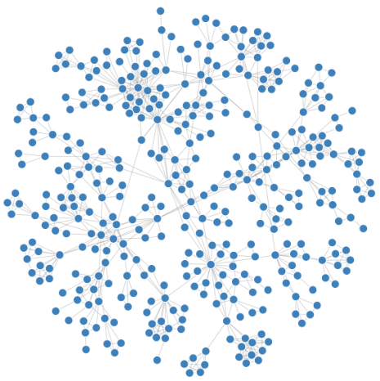
Nodes
Nodes
The NODE is the point of access of a user
  User location (Country/Region)
  EC represented as single node ‘Commission’
Depending on the MS, there can be:
  One node representing the whole country
  OR
  several sub-nodes representing each region (and a Top/Management node representing central management).

Slide 17
Nodes: Hierarchy
Nodes
European Commission
DATA
SENT
DATA
RECEIVED
TOP NODE
Italy
Sub Node
Toscana
Sub Node
Sicilia
Sub Node
Lazio

Slide 18
Nodes: Definitions
Nodes
When 'current node' is Commission:
  only 'Other MS Documents' can be uploaded and sent by the MS
When 'current node' is 'Member State' (e.g. Lithuania):
  All information can be edited by MS
  Official/Integral documents sent when the Object is sent to the Commission
Data considered as sent to the Commission when status is "sent" AND "current node" is "Commission".
The previous and current nodes can be verified in the initial search screen:

Slide 19
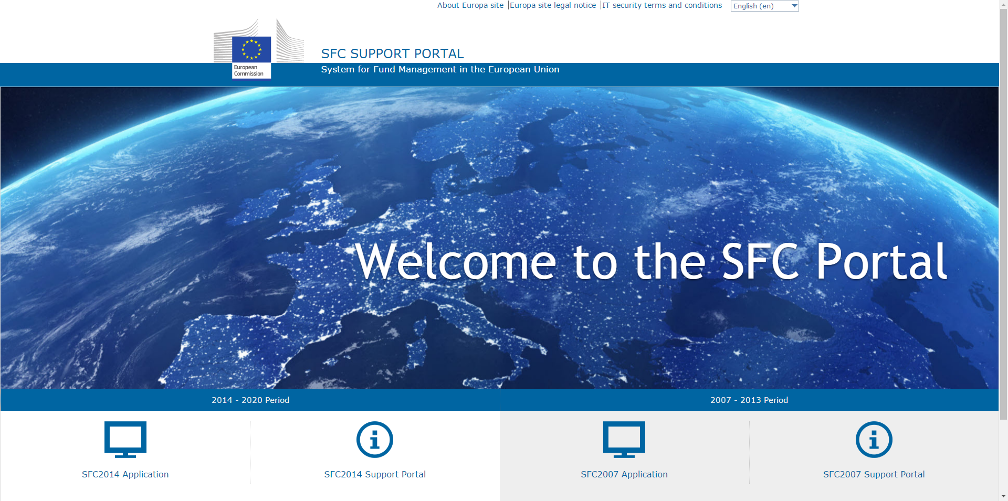
Access SFC2014
Navigating SFC2014
To access SFC2014 go to the SFC Portal: https://ec.europa.eu/sfc/

Slide 20
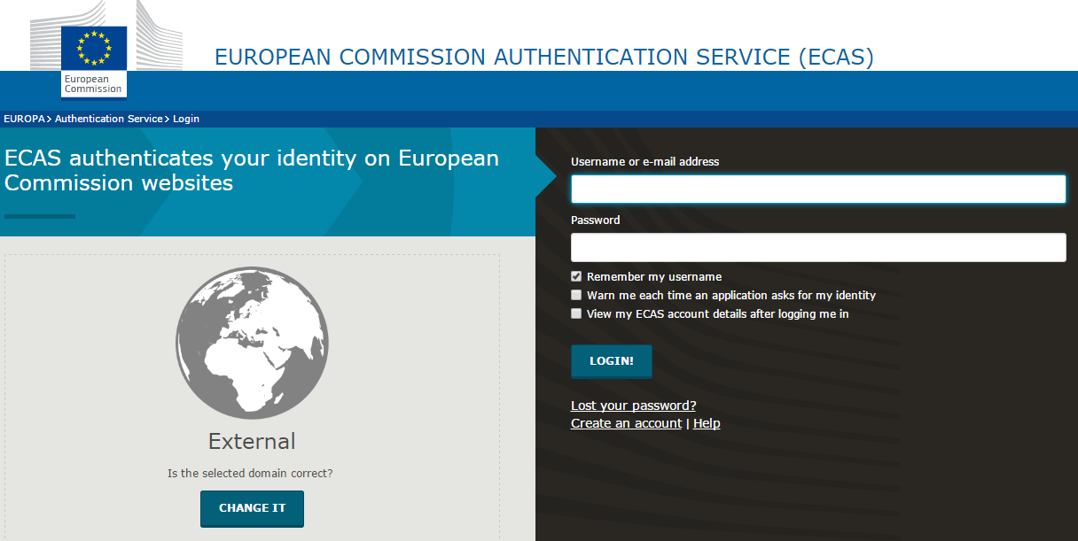
Login ECAS
Navigating SFC2014
→ Remark: Pay attention if the domain displayed is the correct one!

Slide 21
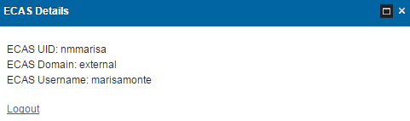
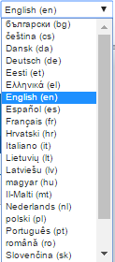

Settings
Navigating SFC2014
On the top right of the SFC2014 screen you will find:
the "Help" option which will redirect you to the SFC2014 Portal
your ECAS details + Logout option
the node you are currently accessing SFC2014 with
Your access profile (you can switch between profiles
when you have more than 1)
the desired Language for the interface

Slide 22
The Business Lifecycle
Navigating SFC2014
Strategic planning
Execution
Audit
Evaluation
Closure
Programming
Monitoring
Support
Process
Utilities
Document Search
Event Registration

Slide 23
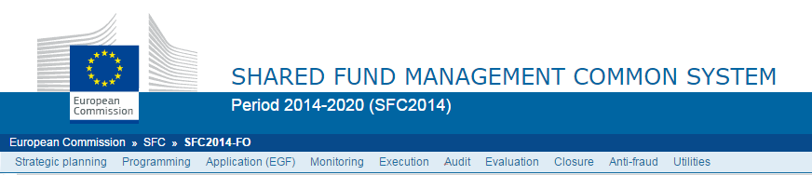
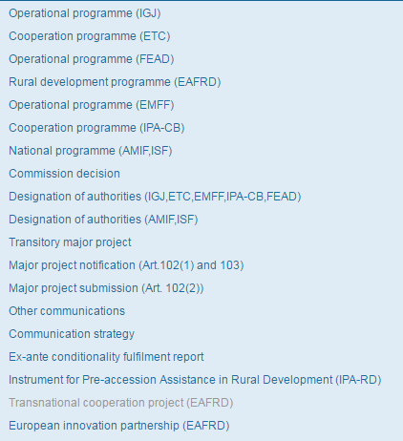
Menu options
Navigating SFC2014
By clicking on the different menu options you will see a drop-down list of items with all the different objects

Slide 24
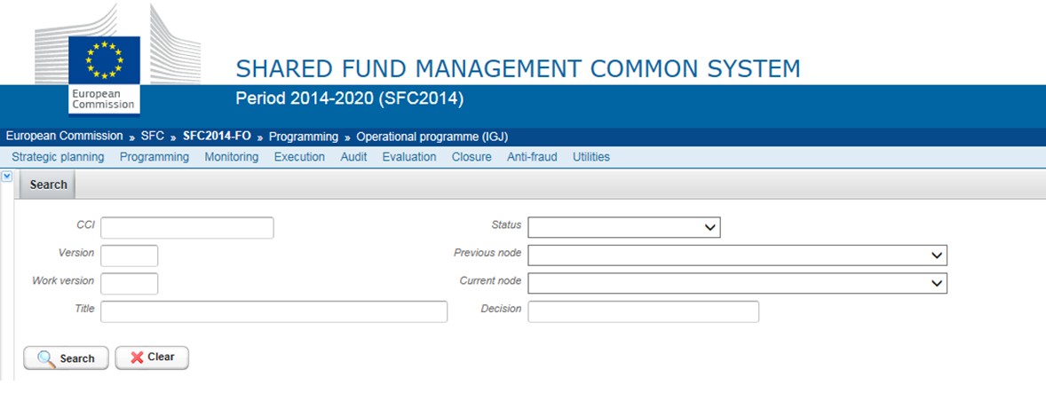
Search and display
Navigating SFC2014
To search in the Front-Office, select a menu item and choose your search criteria from the available fields
You can use wildcards by entering % signs before and/or after the search text to broaden your search results

Slide 25
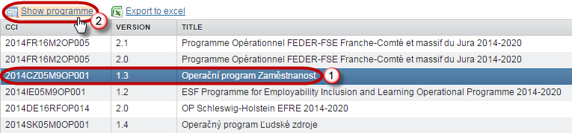
Search and display
Navigating SFC2014
To display a programme from the search results either:
  select the corresponding row (1) and double click on it
  OR
  select the row and then click on "Show programme"(2)

Slide 26
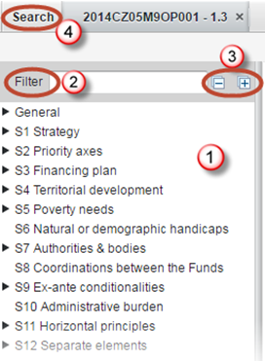
Inside the programme
Navigating SFC2014
(1) Side bar menu with all the items and sub items
(2) Type to search for something specific
(3) Display all items and sub items or only the main items.
(4) To search for another programme, click on the tab "Search"

Slide 27
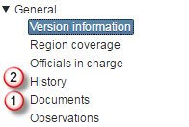
Inside the programme
Navigating SFC2014
Also in the left hand side menu:
Documents (1) all the Documents uploaded by the MS and EC, with their ARES reference, together with the Snapshot & Acknowledgement documents (automatically generated by the system when the Pogramme is sent to the Commission).
History (2) History of actions performed with user and date information.

Slide 28
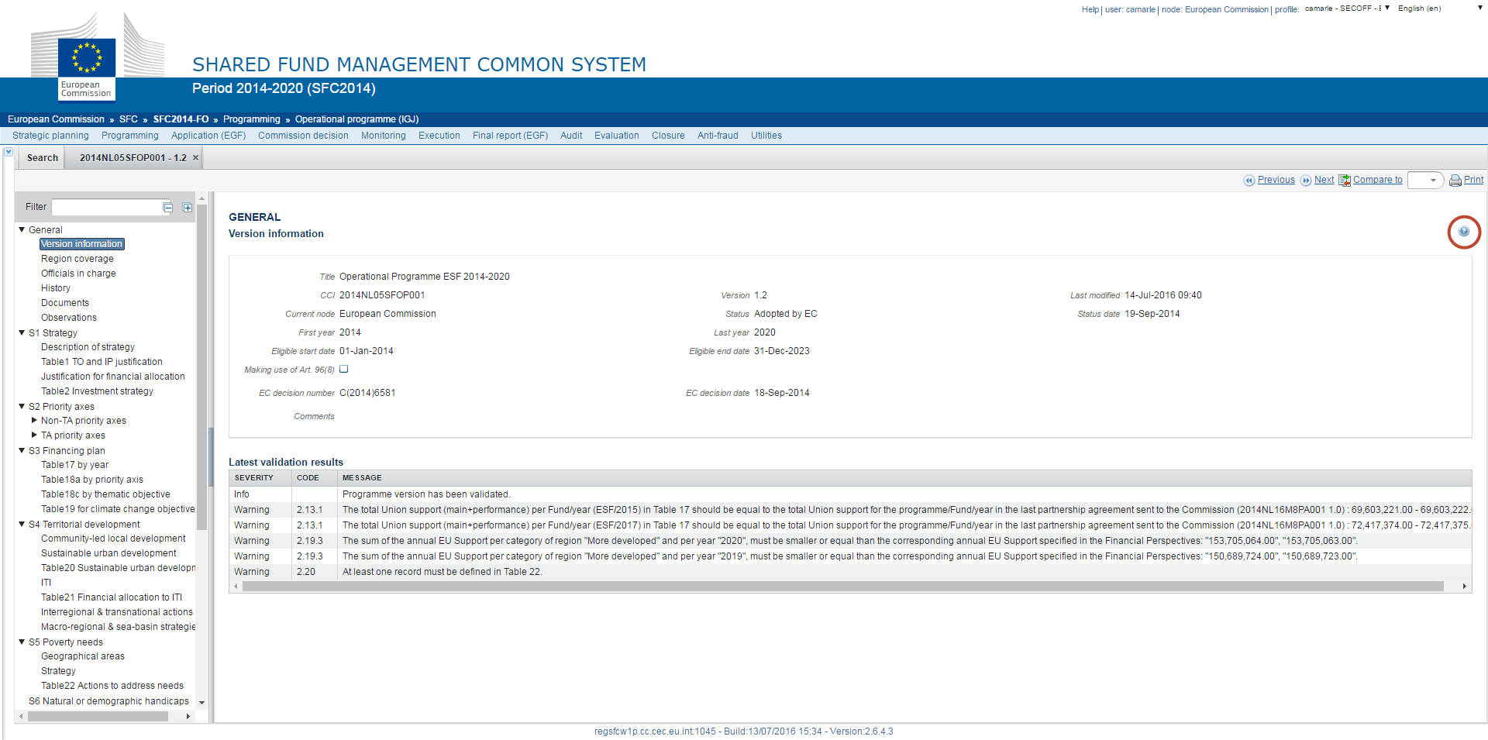

Help
Navigating SFC2014
Inside every object section there is a contextual help available by clicking on the question mark icon.

Slide 29
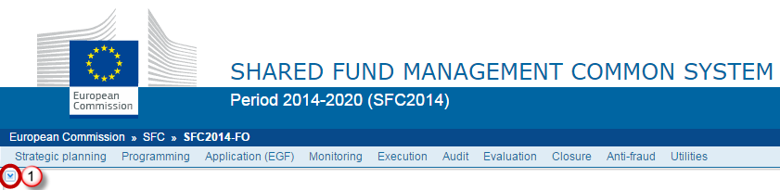

CCI number search
Navigating SFC2014
With the CCI number you can do a specific type of search that will list all related objects at a glance.
Click on the small arrow on the left side of the screen (1). A side bar will open with a field where you can enter the CCI number (2) and Search (3)

Slide 30


Operational Programme
Operational Programmes
Create an OP
Work on it
Validate it
Send it
Decision OK
Adopted by EC
Return for modification
SFC2014
Front Office
WAVE / SFC2014
Create a new version
Work on it
Validate it
Send it
Member State
European Commission

Slide 31
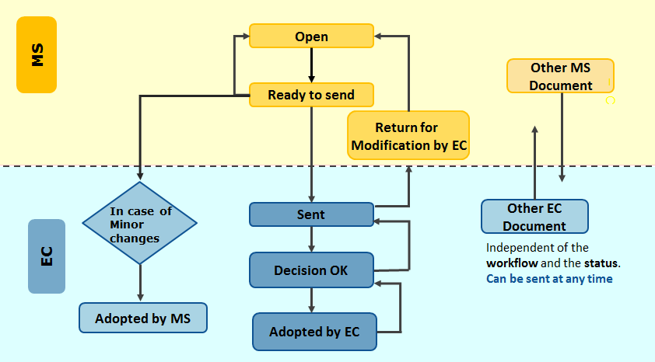
Operational Programme: Workflow
Operational Programmes

Slide 32


Operational Programme: Versions
Operational Programmes
When the EC returns a programme for modification, the MS must create a new version
  Version increases by 0.1 (working version change)
When the Programme is adopted and the MS needs to make changes the MS creates a new version
  Version increases by 1.0 (Major version change)

Slide 33
Returned Operational Programme
Operational Programmes
An OP is returned to the MS when missing elements, allowing MS to edit data and re-upload Official Documents
Any Integral documents must be uploaded again before dossier is validated and sent to EC
Once returned, current node of the returned version remains 'European Commission'

Slide 34
Operational Programme: Versions
Operational Programmes
A new version must be created in order to edit and send a returned OP
The new version is an editable copy of the previous one and it can be created when:
  an object is in its final status*
  an object has been returned for modification
The status is ‘created’ and it can be modified by the MS
Must be validated and sent again

Slide 35
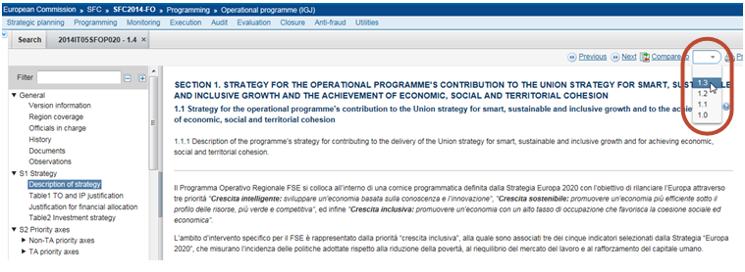
Operational Programme: Compare versions
Operational Programmes
When a programme has more than one version, use the "compare to" function, by choosing the version you want to use as a comparison in the drop-down list:

Slide 36
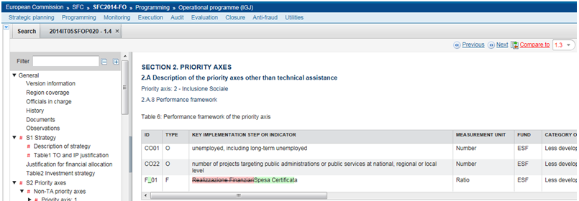
Operational Programme: Compare versions
Operational Programmes
Information added/changed in the new version is highlighted in green
Deleted information appears in red and is striked-through:

Slide 37

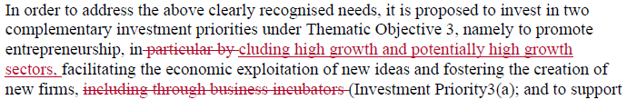
Print
Operational Programmes
Reports can be generated in PDF and Word
If you generate a report while in Compare Mode, deleted information appears in red and is striked-through whereas added/changed information also appears in red but is underlined instead.

Slide 38
Document Management
Document Management
Uploading Documents in SFC2014 can be done via:
Structured Objects (e.g. OP, IR, Payment Applications)
  Structured data to be entered (values, text, tables)
  Documents uploaded as ‘Associated Documents’ as either Integral or Referential document types
Standalone Documents (e.g. Other Communications, Non-reception letters)
  Documents without data, uploaded and sent directly to the EC/MS
→ Remark: Documents are only visible to the Commission when they have been SENT (the 'Sent Date' is completed)

Slide 39
Document Management
Operational Programme
Associated Documents
Integral / Official
Non-Integral / Referential
Sent to EC together with the Programme
Dependent on Object Status
Independent of Object Status
Data (Text, tables, values)
Structured Object
i.e Other MS Document
i.e Report of the ex-ante evaluation

Slide 40
Document Management
Communication Strategy
STANDALONE DOCUMENT
Individual Documents

Slide 41
Document Management
Document Management
Integral/Official documents can only be uploaded/sent when an Object is in a specific status and upon a specific action
Operational Programme (IGJ) Documents:
Integral
Report of the ex-ante evaluation
Created/ Validated/ Returned
Referential
Other MS Document
Any Status
Click on 'Send Official Doc'
Send (OP)

Slide 42
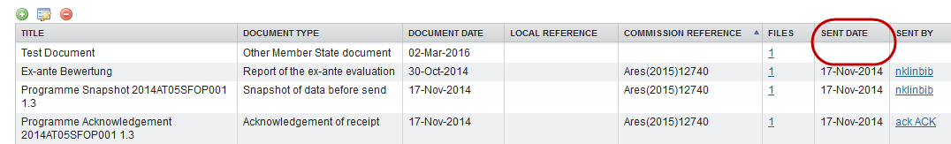
Document Management
Document Management
When data is sent to the Commission, the sender receives an automatic notification from SFC2014
Documents are only visible to the Commission when they have been SENT
  The ‘Sent Date’ must be displayed (check that it is not empty).
In each object (excluding Standalone/referring documents) a snapshot document is added to the 'associated documents' section of the object when the Object has been sent to the EC.

Slide 43
The "four-eyes" principle
Document Management
SFC2014 enforces the "four-eyes" principle, which means that the user who last validated the Object cannot submit it.
  Two different users are required: one to validate it (object status will become 'Ready to Send') and another one to finally send it.
According to Article 3(2) of Commission Implementing Regulation (EU) No 184/2014, “any transmission of information to the Commission shall be verified and submitted by a person other than the person who entered the data for that transmission. This separation of tasks shall be supported by SFC2014 or by Member State’s management and control information systems connected automatically with SFC2014.”

Slide 44

Notifications
Notifications
Informs users about events occurring within the objects:
  status changes, incoming/outgoing documents, deadlines…
3 types of Notifications for SFC2014:
    1. Event Notifications
    2. Notifications as ‘Officials in Charge’
    3. Deadline Notifications for Authorities

Slide 45
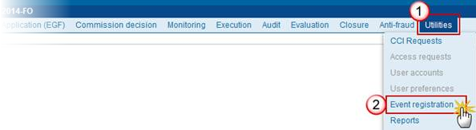
Event Notifications
Notifications
In SFC2014, click on the Utilities menu (1) and then on the Event registration menu item (2)
→ Users are in charge of subscribing/unsubscribing themselves for Event Notifications via this functionality. Inform SFC2014 Liaison to disable your account if necessary.

Slide 46
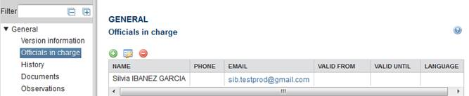
Officials in Charge
Notifications
The concerned user can add his/her email address in the General > Officials in charge section of the object (e.g. Operational/National Programmes)
    → Users are in charge of adding or removing themselves from this section

Slide 47
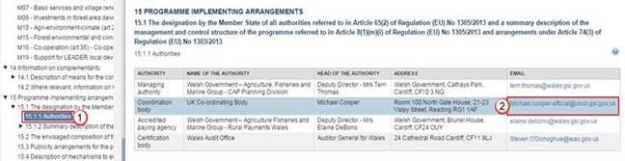
Authorities
Notifications
Automatic Notifications are sent out to the Authorities to warn of upcoming deadlines.
Sent on specific dates pre-defined in the system
Sent to the most recently accepted Authorities information from either:
  The Authorities section inside the OP:
  OR via the Designation of Authorities functionality (Programming menu).
→ Changes to the Authorities must be made in the programme or in the DoA

Slide 48
Practical Demo: Operational Programme
Practical Demonstration
Creation of an Operational Programme in SFC2014
  verification of data
  upload of integral documents ('Report of the ex-ante evaluation' and 'Notification of Designation')
  upload of Other MS document (to be sent manually)
  validate OP
  send OP
Create a New Version of an Operational Programme

Slide 49

Support and Documentation
Support Documentation
SFC Support Portal:
  http://ec.europa.eu/sfc/en/2014
SFC MS Support Material (Latest Information, Regulation sources, Documentation, Guides, Videos):
  http://ec.europa.eu/sfc/en/2014/support-ms
Support contact:
  ec-sfc2014-info@ec.europa.eu

Slide 50
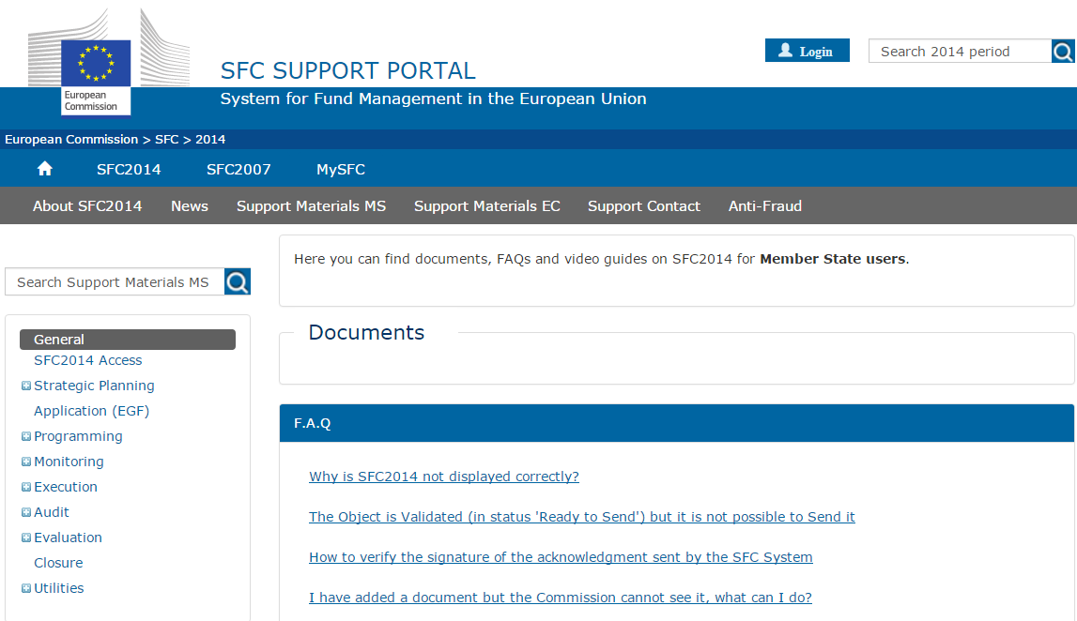
Support Materials MS
Support Documentation

Slide 51
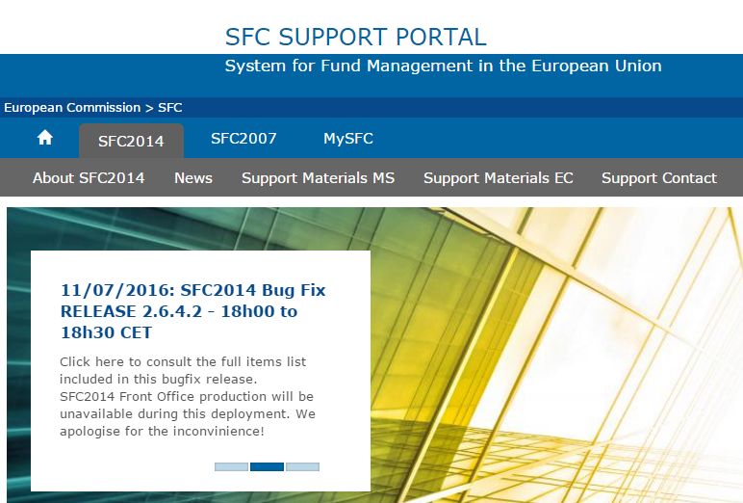
News
Support Documentation
The "News" displays information about the latest releases, planned/unplanned downtime, upcoming deadlines and other important information

Slide 52
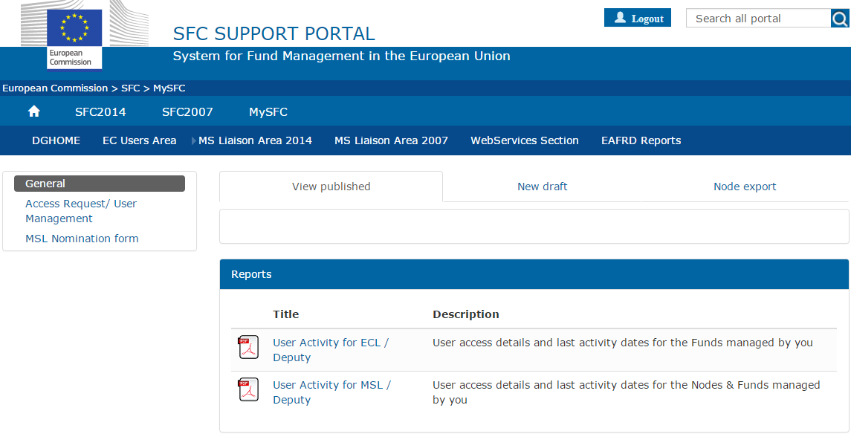
My SFC
Support Documentation
This section requires to display the available reports

Slide 53

Questions
Question & Answer Session

Slide 54

Thank you for your attention!

