Slide 1
Measures for Identifying and Reducing Fraud and Corruption Risks in Public Procurement
OLAF.D.2 – Fraud Prevention Unit

Slide 2
Structure of the presentation
OLAF
Information on corruption from different sources
Study on the costs of corruption in public procurement
EU anti-corruption report
GRECO report on Slovenia
Red flags
Fraud prevention tools and practical guidance

Slide 3
What is OLAF?
The European Anti-Fraud Office.
To protect the financial interests of the European Union (EU) by investigating fraud, corruption and any other illegal activities;
To detect and investigate serious matters relating to the discharge of professional duties by members and staff of the EU institutions and bodies that could result in disciplinary or criminal proceedings;
To support the EU institutions, in particular the European Commission, in the development and implementation of anti-fraud legislation and policies.
Investigations: fully independent
Policy: part of the European Commission
Provide financial support through the Hercule III programme to Member States' authorities and NGOs for actions to prevent and fight fraud against the EU Budget.

Slide 4
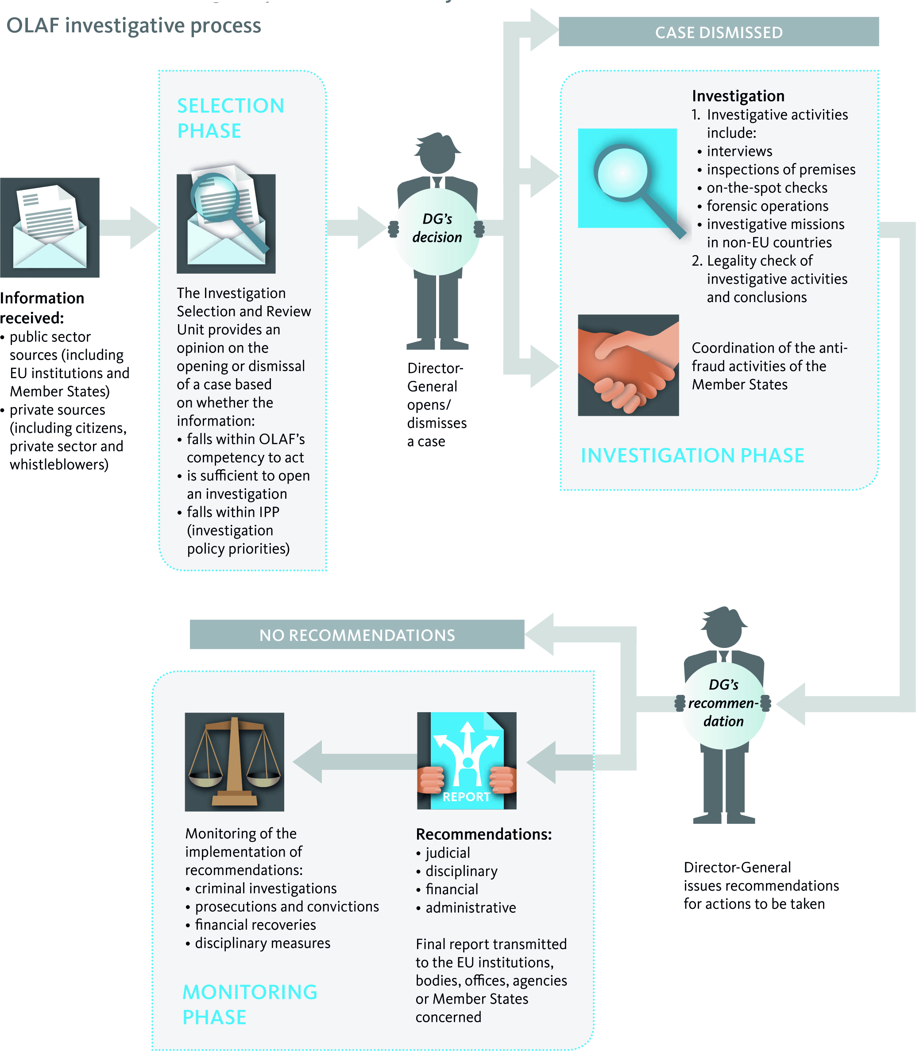

Slide 5
Costs of corruption
Scope of the study: 8 Member States and 5 sectors
Public procurement = about 20% GDP in the EU (2010: € 2.4 trillion)
Direct cost of corruption <2.9% , 4.4%> value of procurement published in OJ
=
EUR 1 470 million and EUR 2 247 million
Notes:
Information based on PWC (Pricewaterhouse Coopers) study Public procurement: costs we pay for corruption.
8 Member States – France, Hungary, Italy, Lithuania, the Netherlands, Poland, Romania, Spain.
5 sectors – Road & Rail, Water & Waste, Utility construction, Training, R&D.
The overall direct costs of corruption in public procurement in 2010 for the five sectors studied in the 8 Member States constituted between 2.9% to 4.4% of the overall value of procurements, published in the Official Journal or between EUR 1 470 million and EUR 2 247 million.

Slide 6
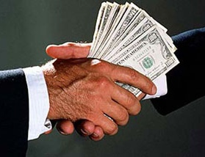
Costs of corruption
Clean projects
Corrupt/grey projects
5% loss
18% loss
Average loss attributable to corruption: 13%
6
Notes:
The direct public loss encountered - in corrupt and grey cases analysed (cases with weaker indications of being corrupt) - amounts to 18% of the overall project budgets concerned, of which 13% can be attributed to corruption.
In Italy, 34% of average case budgets involved in corrupt/grey cases appear to be lost.
• Such direct public losses in corrupt/grey cases are typically a result of:
- Cost overruns;
- Delays of implementation and/or;
- Loss of effectiveness (including inferior quality and questionable usefulness).
• The overall share of budgets lost to corruption tends to be higher in smaller projects than in larger projects, however overall amounts lost are obviously higher in large projects.
• In relative terms, the highest direct public losses are encountered in corrupt training projects (44% of budget volume lost in projects affected), followed by all other sectors (29% in urban/utility construction, 20% in road & rail, 16% in water & waste and 5% in Research & Development).

Slide 7
Costs of corruption
Direct costs of corruption in public procurement
Sector | Direct costs of corruption (in million EUR) | % of the overall procurement value in the sector in the 8 Member States
Road & rail | 488 –755 | 1.9 % to 2.9%
Water & waste | 27 –38 | 1.8% to 2.5%
Urban/utility construction | 830 - 1 141 | 4.8% to 6.6%
Training | 26 –86 | 4.7 % to 15.9%
Research & Development | 99 –228 | 1.7% to 3.9%
Table: costs of corruption by sector (Source: PwC)
7
Notes:
Costs of corruption: The methodology developed by PWC allowed for an estimate of the direct costs of corruption in the 5 sectors.
The methodology is based on the detailed analysis of 96 cases in the sectors. The results of the analysis was fed into an econometric model which estimated results presented in the table above.
Taken together, the overall direct costs of corruption in public procurement in 2010 for the five sectors studied in the 8 Member States is estimated to amount € 1.4 to € 2.2 billion.

Slide 8
Types of corruption
Bid rigging
Kickbacks
Conflict of interest
Other – including deliberate mismanagement/ignorance
Notes:
Types of corruption
During the course of the study, 4 main types of corrupt practices in the 96 corrupt/grey cases were encountered:
• Bid rigging: the contract is ‘promised’ to one contractor, with or without the consent of the public official issuing the tender. Bid rigging takes the form of bid suppression, complementary offers, bid rotation and subcontracting.
• Kickbacks: the public official demands, or is open to, a bribe which will be accounted for in the tendering process, including administrative processes.
• Conflict of interest: the public official has personal interests in the winning company.
• Other – including deliberate mismanagement/ignorance: the public official has not properly carried out checks or followed procedures where this is required and/or tolerates/ ignores overt deliberate mismanagement by a co

Slide 9
Types of corruption - analysis
Type of corruption by sector
Sector | Bid rigging | Kickbacks | Conflict of interest | Deliberate mismanagement
Urban/utility construction | 19 | 14 | 11 | 3
Road & Rail | 10 | 8 | 4 | 1
Water & Waste | 15 | 6 | 3 | 0
Training | 1 | 3 | 2 | 1
Research & Development | 12 | 4 | 2 | 0
Total* | 57 | 35 | 22 | 5
Type of corruption by Member State
Member State | Bid rigging | Kickbacks | Conflict of interest | Deliberate mismanagement
France | 6 | 3 | 5 | 1
Hungary | 9 | 2 | 4 | 0
Italy | 12 | 3 | 4 | 0
Lithuania | 11 | 2 | 1 | 1
Netherlands | 0 | 0 | 1 | 0
Poland | 10 | 6 | 2 | 1
Romania | 4 | 8 | 4 | 1
Spain | 5 | 11 | 1 | 1
Total* | 57 | 35 | 22 | 5
Table: types of corruption identified (Source: PwC)
9
Notes:
The table presents the types of corruption identified in the sample of 96 analysed cases. Certain cases displayed multiple types of corruption, which explains why the number of observations (119) exceeds the total number of cases.
Overall, the study estimates that bid rigging is found in almost half (48%) of practices and most present in Water & Waste and Research & Development projects. Bid rigging is encountered more frequently in Hungary, Poland, Lithuania and Italy.
Kickbacks are encountered in about 1 in 3 cases. This practice appears to be equally spread across all sectors. Kickbacks are the most frequent form of corruption encountered in Spain and Romania.
Conflict of interest practices were encountered in around 20% of cases and across all sectors, though slightly more frequent in the Training and Urban/ utility construction sector.
Deliberate mismanagement was encountered on average in 4% of all practices.

Slide 10
Reactions
Notes:
~10 minutes
Does the perception reflect the reality?
Do you share the opinion of the fraud in public procurement hampers growth?
What could be the ways to improve the situation?

Slide 11
Fraud prevention tools – Red flags
Red flags are:
Warning signals, hints, indicators of possible fraud
The existence of a red flag does not mean that fraud exists but that a certain area of activity needs extra attention to exclude or confirm potential fraud.

Slide 12
Fraud prevention tools – Red flags
Rigged specification:
only one or abnormally low number of bidders respond to request for bids;
similarity between specifications and winning contractor’s product or services;
complaints from other bidders;
specifications are significantly narrower or broader than similar previous requests for bids;
unusual or unreasonable specifications;
the buyer defines an item using brand name rather than generic description.

Slide 13
Fraud prevention tools – Red flags
Collusive bidding:
winning bid is too high compared to cost estimates, published price lists, similar works or services or industry averages and fair market prices;
persistent high prices by all bidders;
bid prices drop when new bidder enters the competition;
rotation of winning bidders by region, job, type of work;
losing bidders hired as subcontractors;
unusual bid patterns (e.g. the bids are exact percentage apart, winning bid just under threshold of acceptable prices, exactly at budget price, too high, too close, too far apart, round numbers, incomplete, etc);
Notes:
Additional red flags for collusive bidding:
- apparent connections between bidders, e.g. common addresses, personnel, phone numbers etc;
- contractor includes subcontractors in its bid which are competing for the main contract;
- qualified contractors fail to bid and become subcontractors or low bidder withdraws and becomes a subcontractor;
- certain companies always bid against each other, others never do;
- losing bidders cannot be located in the Internet, business directories, have no address etc (in other words they are fictitious);
- correspondence or other indications that contractors exchange pricing information, divide territories, or otherwise enter informal agreements;

Slide 14
Fraud prevention tools – Red flags
Conflict of interests:
unexplained or unusual favouritism of a particular contractor or seller;
continued acceptance of high priced, low quality work etc;
contracting employee fails to file or complete conflict of interest declaration;
contracting employee declines promotion to a non-procurement position;
contracting employee appears to conduct side business.
close socialisation between a contracting employee and service or product provider;
unexplained or sudden increase in wealth by the contracting employee;
Notes:
Additional red flags for conflict of interests:
- contractor has a reputation in the industry for paying kickbacks;
- undocumented or frequent changes to contracts increasing the value of the contract.

Slide 15
Fraud prevention tools – Red flags
Manipulation of bids:
complaints from bidders;
poor controls and inadequate bidding procedures;
indications of changes to bids after reception;
bids voided for errors;
a qualified bidder disqualified for questionable reasons;
job not re-bid even though fewer than the minimum number of bids were received.
Notes:
Definition
Manipulation of bids: In a poorly controlled bidding process contracting personnel can manipulate bids after receipt to ensure that a favoured contractor is selected (changing bids, “losing” bids, voiding bids for alleged errors in specifications, etc)

Slide 16
Fraud prevention tools – Red flags
Split purchase:
two or more consecutive, related procurements from the same contractor just under competitive bidding or upper level review thresholds;
unjustified separation of purchases, e.g. separate contracts for labour and materials, each of which is below bidding thresholds;
sequential purchases just under the thresholds

Slide 17
Reactions
Notes:
10 minutes
Does your organisation use red flags?
What is their impact? Limited?
Do you find them useful?

Slide 18
Fraud prevention tools – Practical guides
Detection of forged Documents in the field of structural actions. A practical guide for managing authorities.
Identification of conflict of interests in public procurement procedures in the field of structural actions.
Access to the practical guidance is restricted to Member States' staff. They can be found on SFC 2007.
Notes:
Those guidelines were prepared by the representatives of national public administration: inputs were combined together in OLAF.
It was done by the administration for the administration.

Slide 19
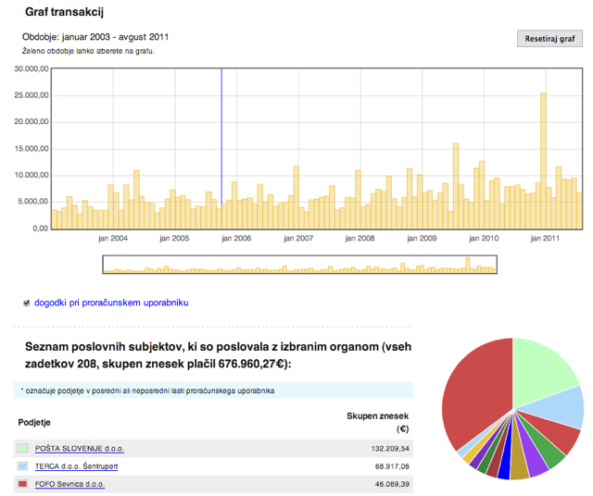
Good practice – transparency platforms
Transparency of public expenditure, the SUPERVIZOR platform
Good practice, despite limited use by public.
Notes:
The Supervizor application: contains over 50 mio. transactions from both government and local agencies to government contractors from 2003 to 2013 matches such transactions to company records, including director lists and corporate leadership use the actual bank transactions from public bank accounts at the Slovenian National Bank as source data, making the records highly reliable According to the developer behind the platform, the granularity of the data has enabled statisticians and analysts to make statistical models available, including a Hidden Markov model of the data. Over the years, the platform has helped identify shifts in contractor purchases around changes in the political leadership. Lack of impact? Despite its comprehensive content and site visualisations, however, the site has not received any significant response from journalists or CSOs. While it is not reasonable to speculate based on the available interview, we find it worth considering how one of the most transparent spending platforms should suffer from limited use.
http://community.openspending.org/research/mappingcommunity/case-studies-spending/supervizor/#sthash.vdO66DAM.dpuf

Slide 20
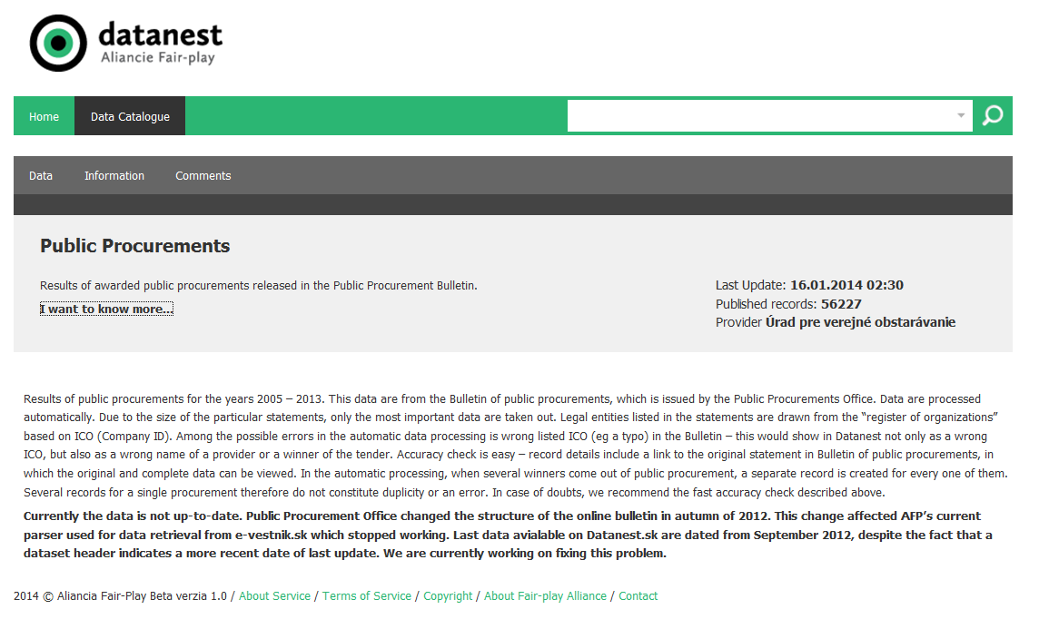
Fraud prevention tools – Transparency
Retrieved from http://datanest.fair-play.sk on February 6, 2014
Notes:
Good practice: database for tracing public money
Slovakia reformed its access to information laws in 2000 and created a system that has become exemplary over the last decade. Freedom of access to information has allowed NGOs and think-tanks to devise innovative solutions to flag risks and to build an information network allowing the detection of conflicts of interest and improper influence on decision making. The NGO Fair Play Alliance created a database that anyone can access via their website. The database focuses on public money paid to private entities (state subsides, privatisation, tax and custom remissions, grants, European funds, debts to the public sector) and on public representatives (managers of state institutions, governments, elected positions, the judiciary, self-governing bodies, Parliament, advisers to political leaders). It provides media and NGOs with tools for monitoring and makes public administration aware of the fact that their decisions can be easily monitored. This database is also helpful for investigative journalism; for example, the media were able to draw attention to concrete allegations of illicit practices regarding political party finance including fake donors and non-transparent party loans. The network has been emulated by NGOs abroad and the software is used in the Czech Republic, Hungary and Georgia. The know-how is also used in Montenegro.
The EU Anti-Corruption Report – Annex – Slovakia p.7

Slide 21
Discussion
Notes:
~10 minutes
Would you be interested in guidelines developed by the Commission?
Is transparency an option for Slovenia?
What would be the benefits of global and transparent data base?

Slide 22
Thank you for your participation!
OLAF.D.2 – Fraud Prevention, Reporting and Analysis Unit
OLAF - European Anti-Fraud Office
European Commission
Rue Joseph II 30
B–1049 Brussels
http://ec.europa.eu/anti_fraud

